Slide 1
GRADE 4
UNIT 3
MY THINGS!
LESSON 1

Slide 3
Listen and point

Slide 4
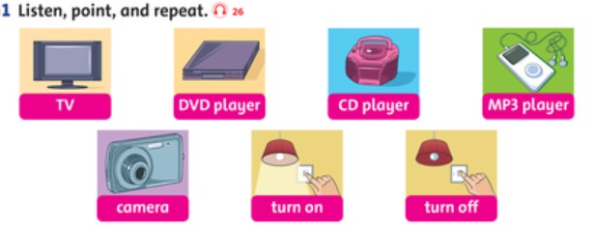

Slide 5
Listen and repeat

Slide 6
TV

Slide 7
DVD player

Slide 8
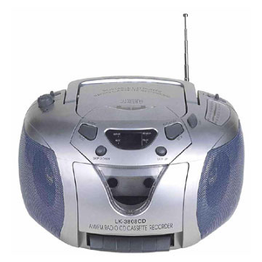
CD player

Slide 9
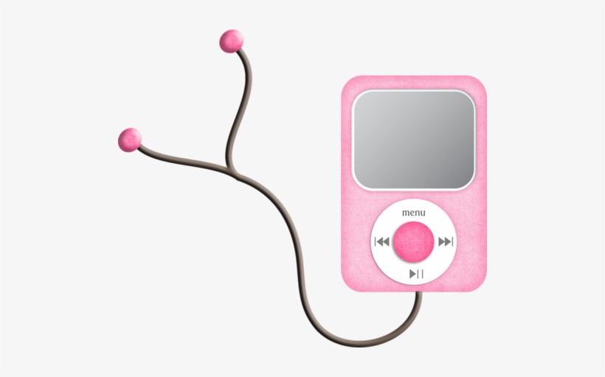
MP3 player

Slide 10
camera

Slide 11
turn on

Slide 12
turn off

Slide 13
Tasks: Watch the video and answer these questions
Where are they?
What are they doing?

Slide 15
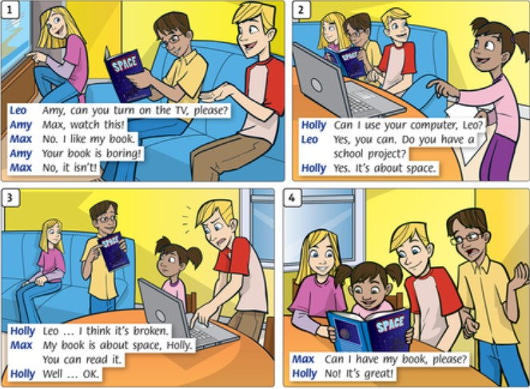

Slide 16
GRADE 4
UNIT 3
MY THINGS!
LESSON 2

Slide 18
I have a CD.
This is my CD.

Slide 19
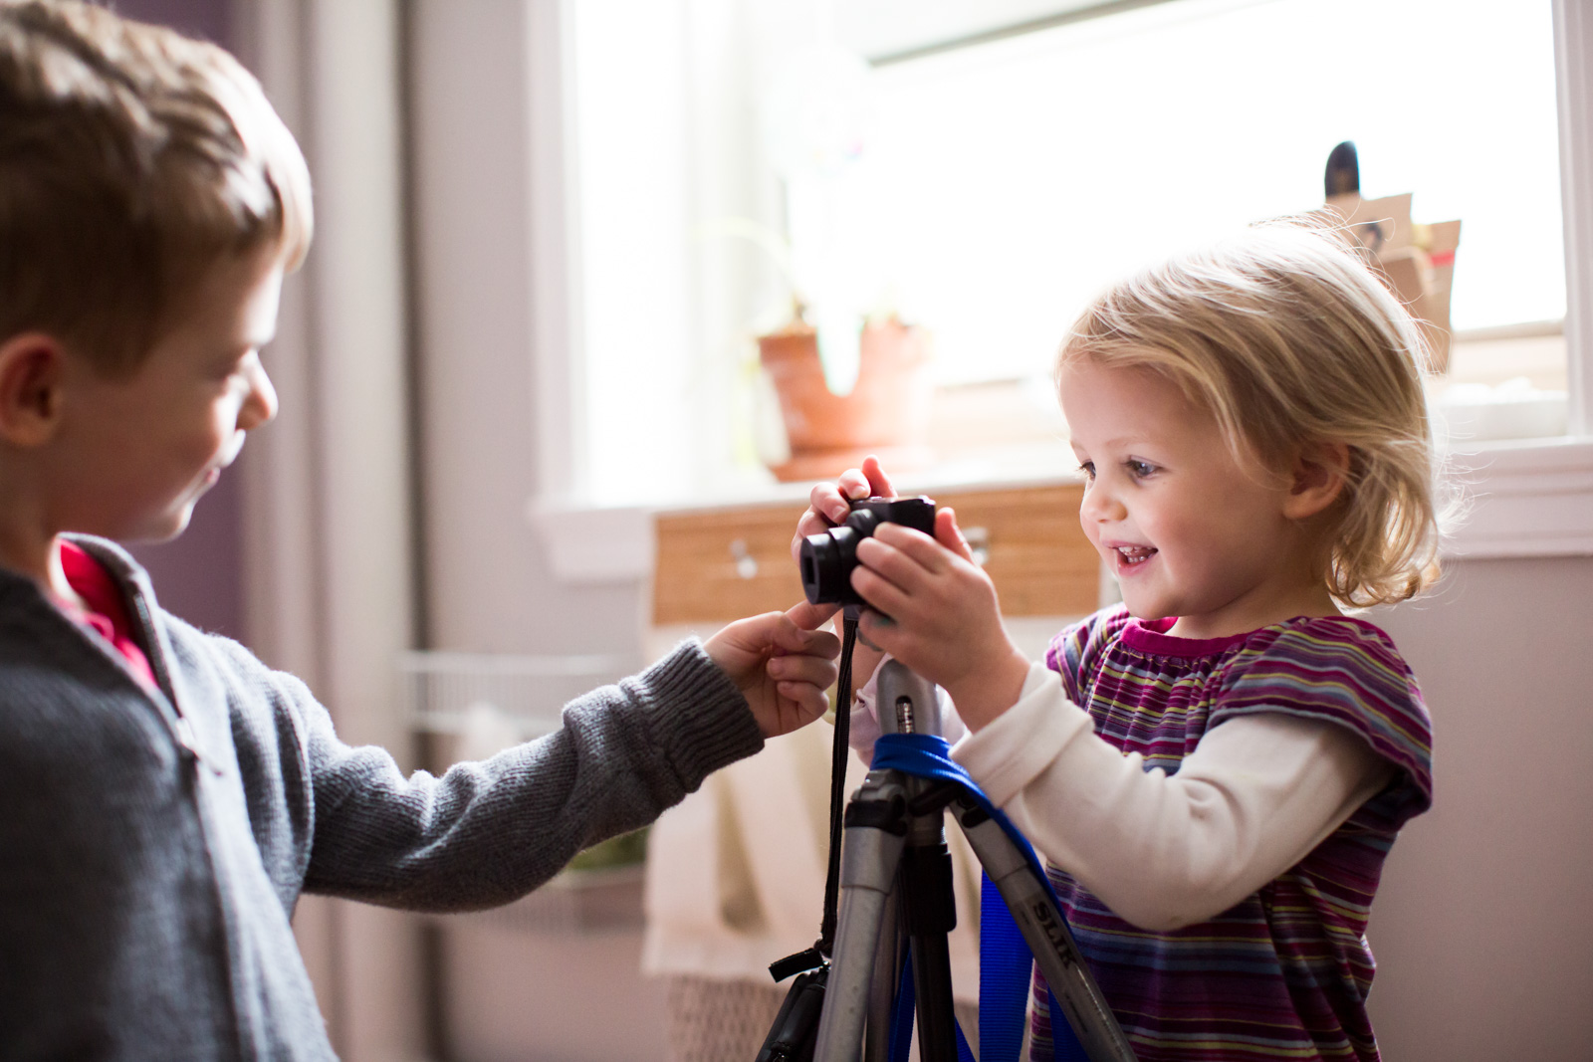
We have a camera.
This is our camera.

Slide 20
Let’s play a game.

Slide 21
your
her
my
its
their
our
his

Slide 22
You have a new MP3 player.
______ MP3 player is pink.
my
Your
her
your

Slide 23
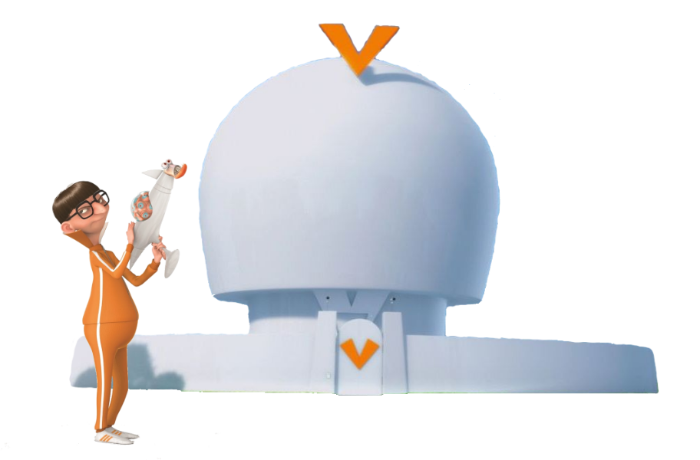
They live in a white house.
______ house is big.
Their
Your
Our
Their

Slide 24
I have a camera.
______ camera is brown.
my
My
Their
Your

Slide 25
They are going to school.
______ school is big.
their
Their
your
our

Slide 26
We have a DVD player.
______ DVD player is cute.
Your
Our
their
our

Slide 27
They are my sisters.
______ names are Jane and Julie.
Your
Their
our
Their

Slide 28
We are playing at home.
_____ mom is at work.
Our
Their
Our
your

Slide 29
Good job

Slide 30
Write: your / our / their
Their
Our
your
their
our

Slide 31
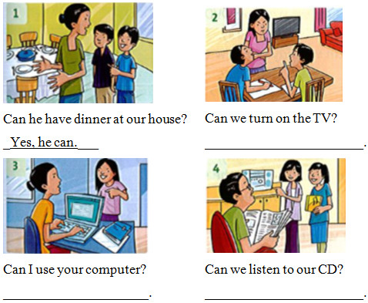
Write
Yes, we can.
Yes, you can.
Yes, you can.

Slide 32
GRADE 4
UNIT 3
MY THINGS!
LESSON 3

Slide 33
Ask and answer.

Slide 34
Close your book and write three questions
Example:
Can you open the window, please?

Slide 35
Listen and point

Slide 37
LISTEN and SING

Slide 39
Workbook time!!!

